Slide 1
Config Server
By team DROVZ

Slide 2
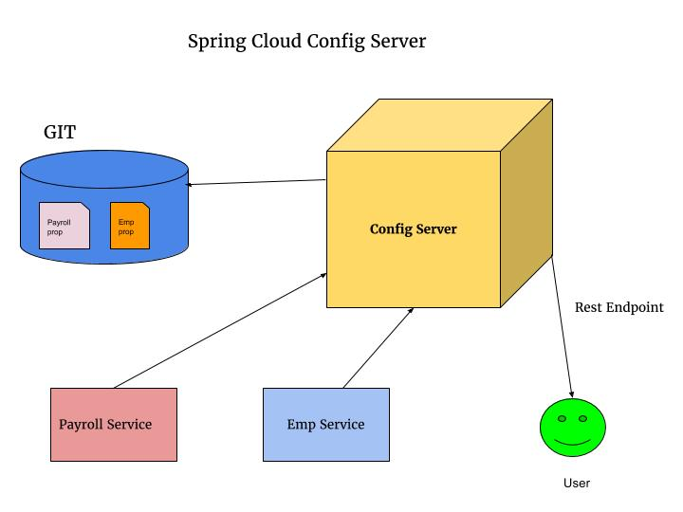
Basic Concept

Slide 3
Advantages
Disadvantages
Services don’t need to be rebuilt
Only 1 config file shared across all services
Easily embedded in Spring Boot
Property Encryption
Properties stored on id
Configurations on server reloaded dynamically after each change committed in the git
More overhead starting services
If server down clients can’t start or use possibly conflicting configurations
Another application that needs to be maintained

Slide 4
Config Server General Idea:
Eliminates creating properties in every service
Making changes in server; reflected in services
Property files locations: Source Control Locations or Filesystem
Notes:
Without a config server, you will have to create your own consistent configurations located inside of each service
With a config server, you only need to create the configurations in one place and it is shared across all available services
Allows you to make changes that will be reflected in other services without having to rebuild those services
The property files are generally located in a version controlled system (such as Git), but can also be stored in a filesystem(generally not used for production environments)

Slide 5
How to use
It is a HTTP, resource-based API for external configuration (name-value pairs, or equivalent YAML content)
Bootstrap Ex:
Config Service
@EnableConfigServer
Give your config service the repo url
Each service to use
Spring:
Application:
name=flashcard-service-1
Config:
Port: 9001

Slide 6
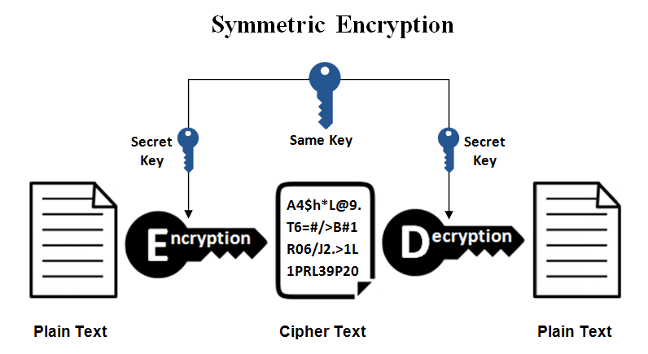
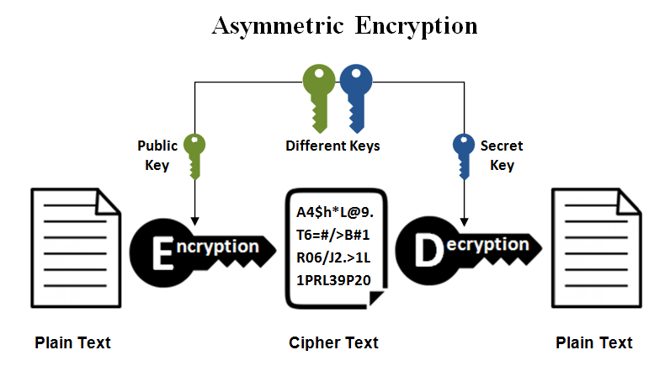
Property Encryption
Can Encrypt and decrypt property values (symmetric or asymmetric)
Can disable server side encryption with:
spring.cloud.config.server.encrypt.enabled=false

Slide 7
Property Encryption Example
In application.yml-
spring: datasource: username: dbuser password: '{cipher}FKSAJDFGYOS8F7GLHAKERGFHLSAJ'

Slide 8
Sources
Sources: -https://spring.io/guides/gs/centralized-configuration/ -https://cloud.spring.io/spring-cloud-config/ -http://callistaenterprise.se/blogg/teknik/2017/05/12/building-microservices-part-6-configuration-server/
-http://www.baeldung.com/spring-cloud-configuration
-https://dzone.com/articles/microservices-and-spring-cloud-config-server

